Slide 1
SafeNavi
Navigation on glasses
Navigation screen is Displayed on your Glasses

Slide 2
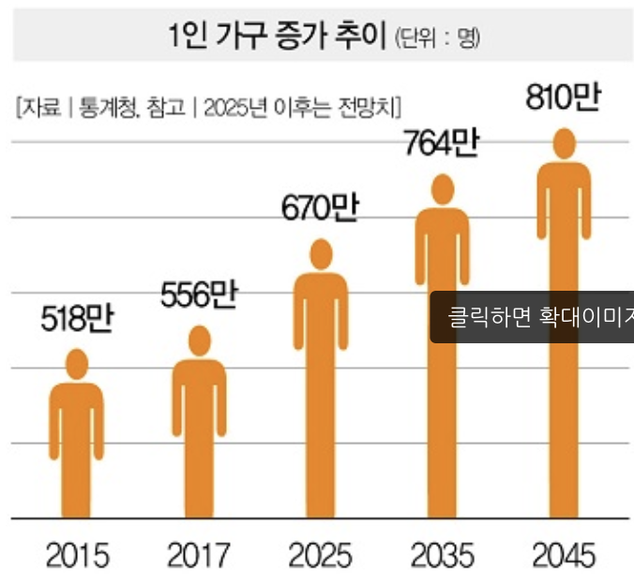
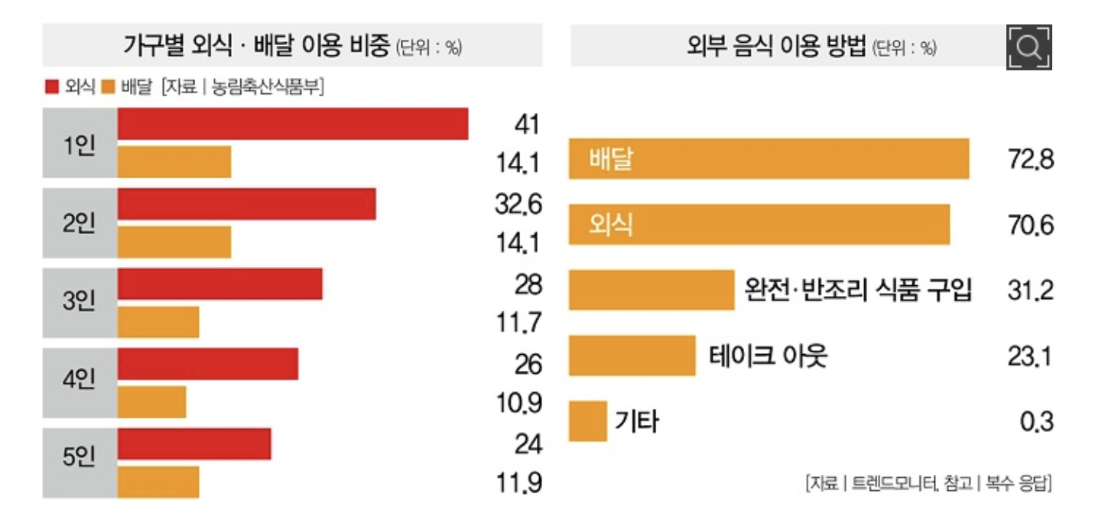
Market Research
Demand of delivery is increasing
Delivery demand The rate of delivery of food in one household is 14.1%, which is the highest overall.
As the payment service using mobile phones evolved, the category of e-commerce was broadened.

Slide 3
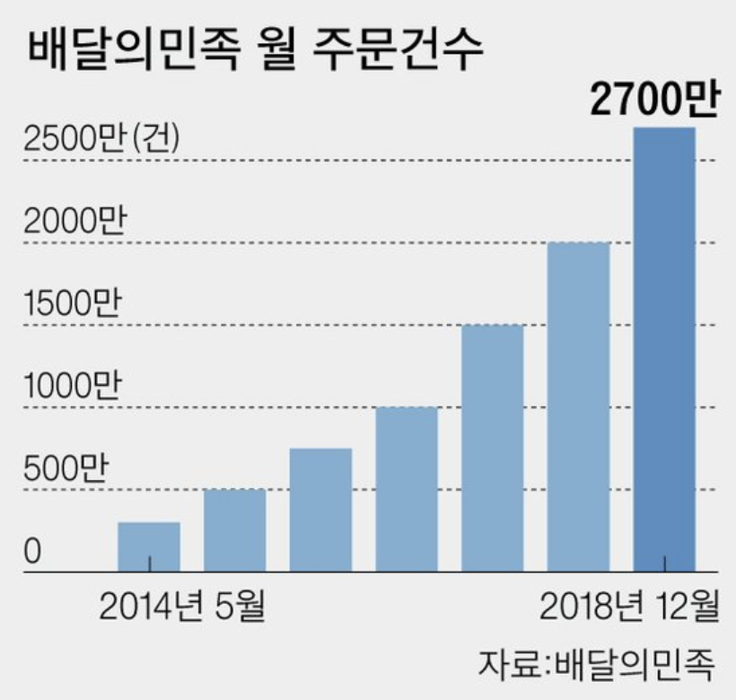
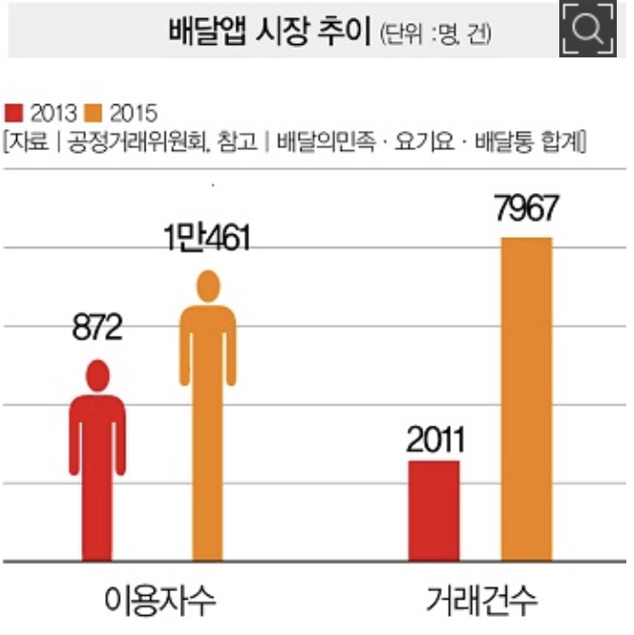
Market Research
Demand of delivery is increasing
Delivery apps have an opportunity to increase the demand for delivery and to expand the
e-commerce market. It is growing greatly.
The nation of delivery raised the sales of 49.5 billion won more than four times in 2015.

Slide 4
Market Research
Demand of delivery is increasing
Therefore, as the demand for delivery increases, the number of motorcycle accidents
and casualties also increases.

Slide 5
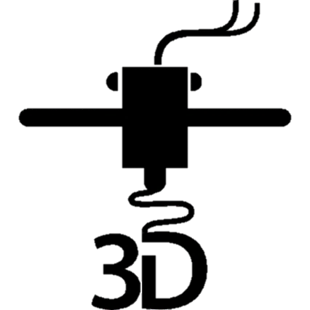
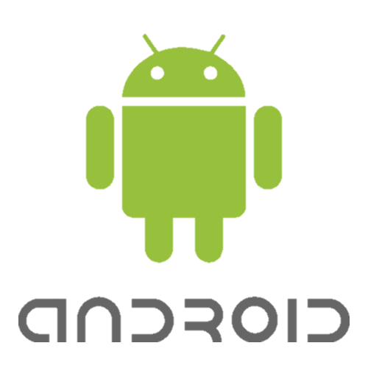
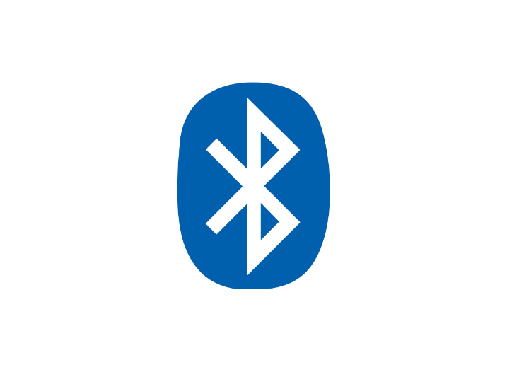


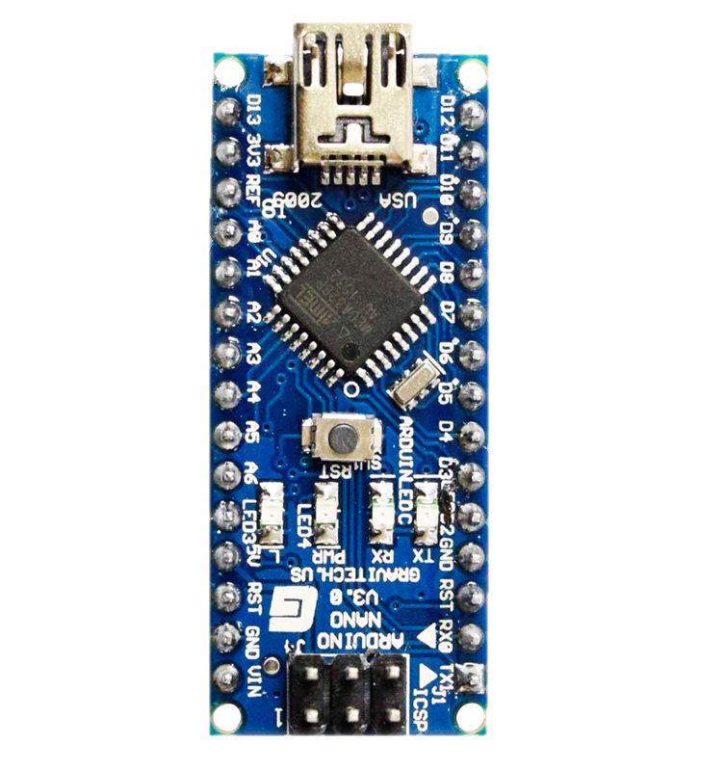
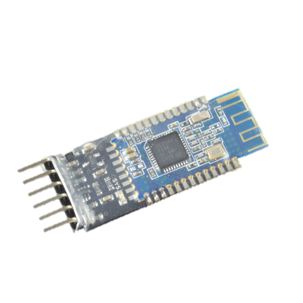
Technology
Application
Arduino Glasses
3D Printer
Bluetooth
TMap API
GPS
Arduino

Slide 6
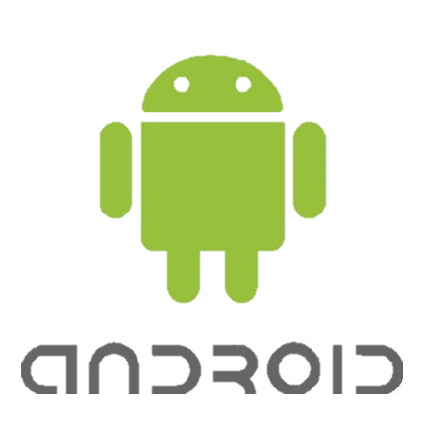
Android Application
Navigation
Find User’s Location
Set Starting Point
GPS
Search Path to Destination
Find Information about the Path
The information contains directions from each POI to destination, POIs and etc
Send the Information to App
TMap API
Show Map
Give Path Information to Destination
Find the nearest POI (Point of Interest) on the path and the directions to the POI
Send Information to Arduino using Bluetooth

Slide 7
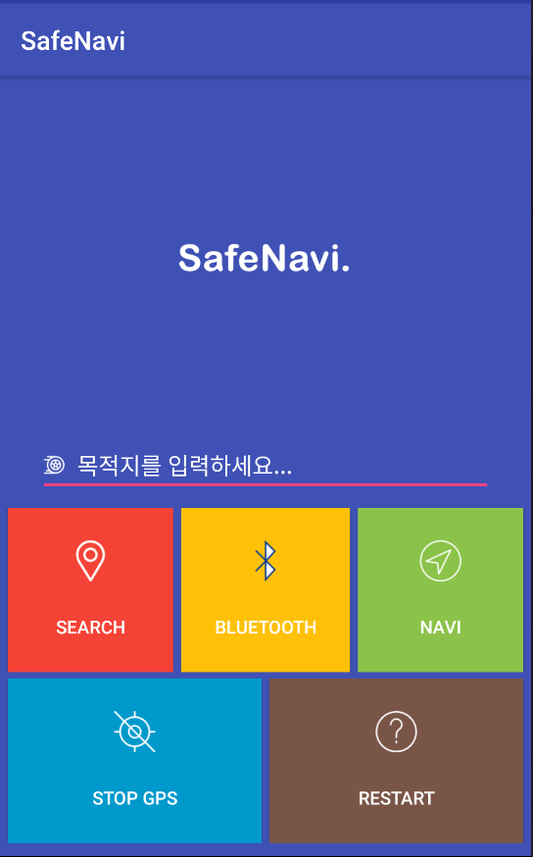
Android Application
Navigation
Search Bar
Enter your destination
It finds your destination automatically according to what you enter
Must select your destination
④ Navi Button
Click this button
It starts to send information of directions and rest distance to next POI
② Search Button
Click this button
You can see a map with a path from current location to destination that you entered
Navi Button
When you click this button
It initialize this application
You can enter new destination
③ Bluetooth Button
Click this button
You can check your bluetooth state
You can see a bluetooth device list that can be used
Select ‘HC-05’(Arduino Glasses)
It connects the device
Navi Button
When you click this button
It turns off GPS service

Slide 8
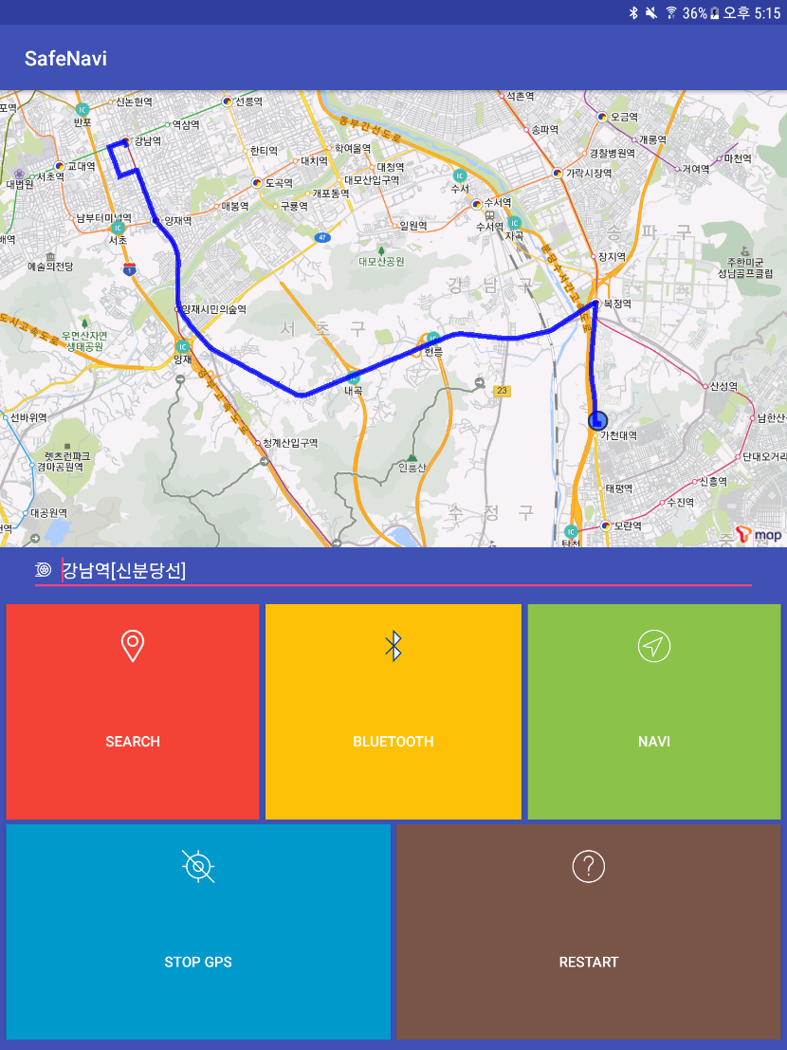
Android Application
Navigation
Map with a Path to Your Destination
When you click the search button
You can see this scene
Path from Your Location to Destination
This path contains information about POIs, directions at each POIs, roads and etc on the path
It finds the direction that you should go, wherever you are, using the information
It finds the nearest POI on the path, wherever you are, and guides the direction and the rest distance to the POI
And they are sent to the arduino glasses

Slide 9




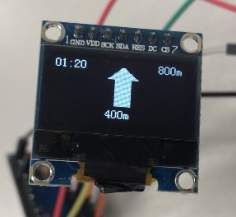
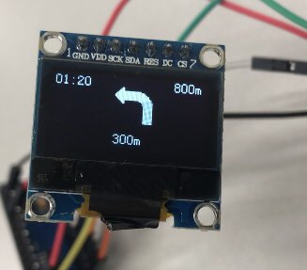
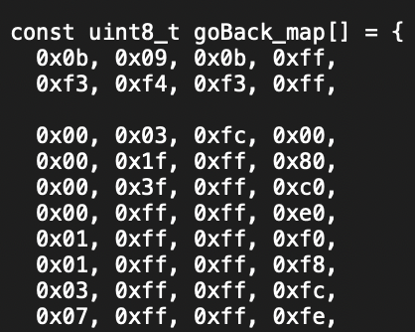
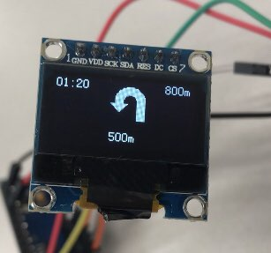
Arduino Glasses
Structure
Overall structure of the arduino
How to make an images
Load the hex code on display
Draw BMP
Arduino Nano
Atmega 328p
5V, 16Mhz
OLED 0.96 Inch
SPI
128x64
Using SSD_1306 library
HC-05
BLE module
Convert to hex code
Lipo Charger
3.3V 330mAh
Hex Code File
Now we can draw any bmp images

Slide 10
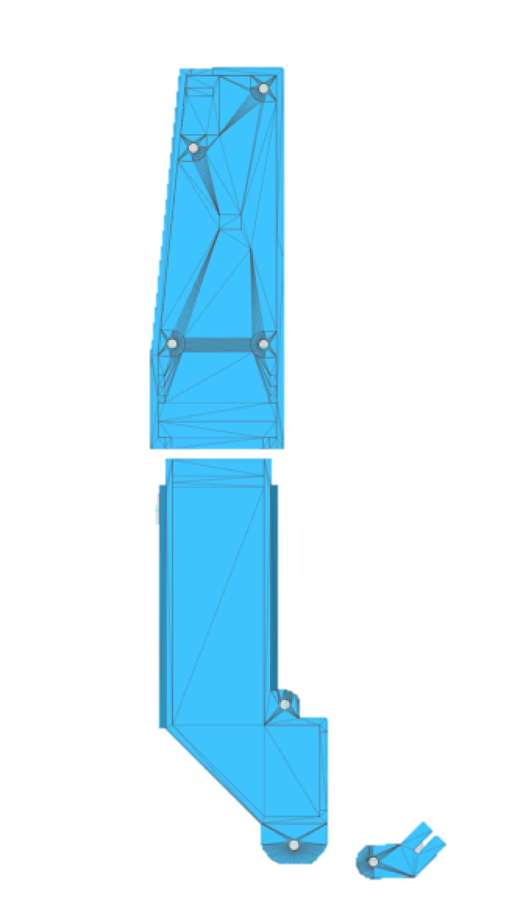
Arduino Glasses
Container
Components Container
Put arduino components in here
It contains nano, OLED, BLE module, battery
Container
Container is designed by 123D Design and printed by 3D printer
5
3
2
1
③ Hinge
The Reflector is placed at hinge
The images pass through the reflector and focused on user’s eye
4
② Middle Part
The Images displayed in OLED reflect through here
Mirror is placed at the corner
⑤ Components Position
Arduino Nano
Bluetooth module HC-05
LiPo battery
OLED display
Switch
Mirror
Reflector
6
7

Slide 11




Marketing Plan
SWOT
Applying our solution to diverse devices
Cheap price to develop and to manufacture
Easy customizing to diverse devices
Small display can produce only limited information
Poor Visualization → Need Distance Calculation
S
Strength
강점
W
Weakness
약점
O
Opportunity
기회
T
Threat
위협
As the delivery market grows
demand for various accessories for vehicles increases.
Diverse HUD and other display products are released

Slide 12
Business Plan
Promotion
Small display & Poor Visualization → Need Distance Calculation
Catch a target and diversity devices based on prototype
Target: helmet manufacturing co., front glass manufacturing co., vehicle addictive manufacturing co. etc.
Similar to Google Glass → Increase Price Competitiveness
B2B solution: Delivery Market
Those who need Navigation with Hands-free
Bike users, car users
Hands-free Navigation with exact information
Show speed, distance, direction with Arduino and Mobile Application
Make competitiveness with price to Google Glass
Customer
Value
SafeNavi
Profit

Slide 13

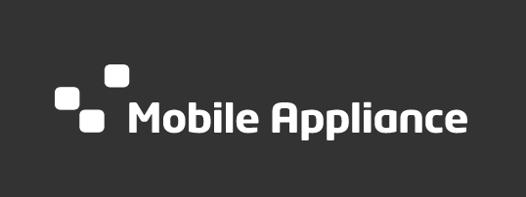
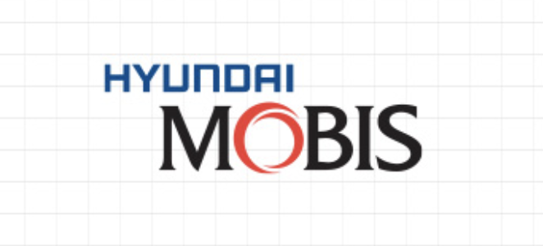


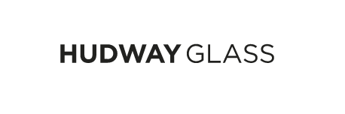
Business Plan
B2B Business Model
Target Companies
Helmet
HUD
Vehicle Instruments Provider

Slide 14
Business Plan
B2B Business Model
Needs
Growth of Delivery Market
We can predict that demand for various accessories for vehicles increases.
Our solution for vehicle accessories
It can enhance the competitiveness of vehicle display products.
So, It can provide competitiveness of products of the target companies
Cheap price because of low cost.
Easy customizing to diverse devices.

Slide 15
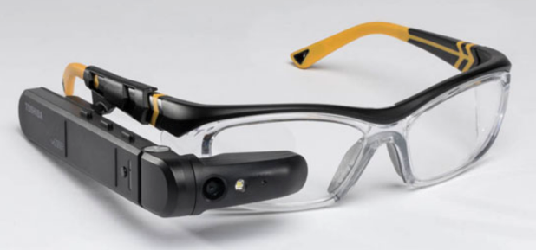
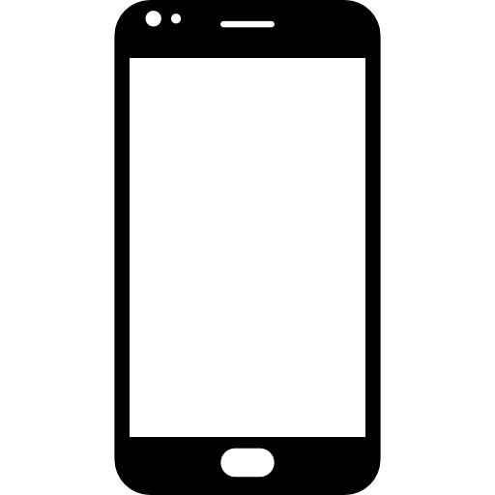
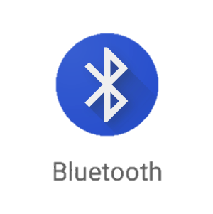
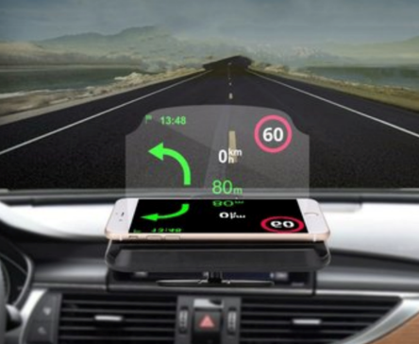
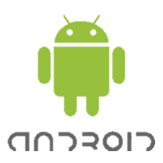
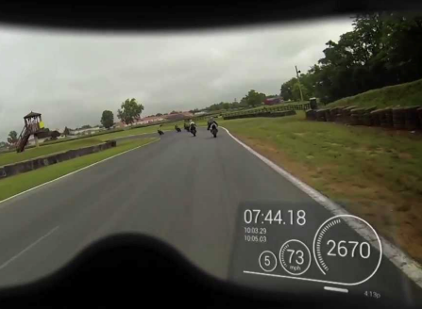
Business Plan
B2B Business Model
How
Based on the prototype, it is launched as a glass device.
Make various types of devices (Glass, Helmet, HUD, Projector).
Low price and good performance, great appeal to big company, also SMEs.
glasses
prototype
?
HUD
projector

